Slide 1

Welcome to DailyElderMeds - Your Daily Dose of Care
Empowering Seniors for a Healthier Tomorrow
Caring for Our Elders, One Pill at a Time

Slide 2
Problem Statement
"Elderly individuals often face challenges in managing their daily tasks, including medication adherence, emergency contacts, and effective communication with caregivers. A significant problem arises from the lack of user-friendly and easily accessible tools to aid in these tasks."

Slide 3
Solution
EarlyElderMeds aims to bridge this gap by offering a comprehensive and user-friendly web interface designed exclusively for elderly users. It facilitates streamlined management of daily tasks, encompassing medication schedules, emergency contact accessibility, and seamless communication with caregivers
*Key Features:*
Medication Management
Emergency Contacts
Caregiver Communication
Remote Monitoring
Chat Bot Feature

Slide 4
Welcome to our Website
Welcome to our dedicated platform designed to make life easier for seniors. At DailyElderMeds , we understand the importance of health and safety, especially for our cherished older generation. Our mission is simple yet profound: to ensure that medication management becomes effortless and emergency assistance is always within reach. With a user-friendly interface and a range of essential features, we aim to provide peace of mind to both elderly individuals and their families. Join us on this journey to prioritize well-being and independence for our beloved seniors.

Slide 5
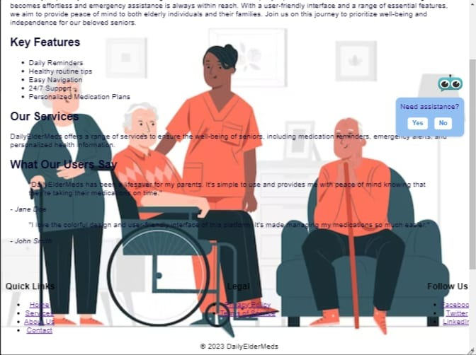
Colorful Design: DailyElderMeds boasts an appealing and user-friendly interface, incorporating bright and engaging colors that resonate with seniors.
Engaging Content: The website provides essential information and resources, making it a valuable source of knowledge for both seniors and their families.
Easy Navigation: The site's intuitive navigation ensures that users of all ages can access the information they need effortlessly.
24/7 Support: DailyElderMeds offers around-the-clock support, ensuring seniors have assistance whenever they require it.Personalized Medication Plans: The platform assists seniors in managing their medications efficiently, offering personalized plans and reminders.

Slide 6
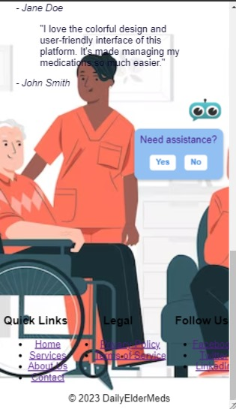
Services:DailyElderMeds offers a comprehensive range of services, including medication management, emergency alerts, and personalized health information. This website aims to provide peace of mind to both seniors and their families, guaranteeing that medication management becomes effortless and emergency assistance is always within reach.
Testimonials:Users have already praised the platform, with testimonials highlighting the lifesaving qualities and user-friendly interface. It's a game-changer in managing medications and enhancing the well-being of our elderly population.
Footer:The website's footer contains quick links to essential pages, legal information, and social media links, enabling visitors to navigate and connect with the platform seamlessly.
Follow Us:To stay updated, users can follow DailyElderMeds on social media platforms such as Facebook, Twitter, and LinkedIn.Legal:The website ensures transparency and legality with clearly accessible privacy policies and terms of service.

Slide 7
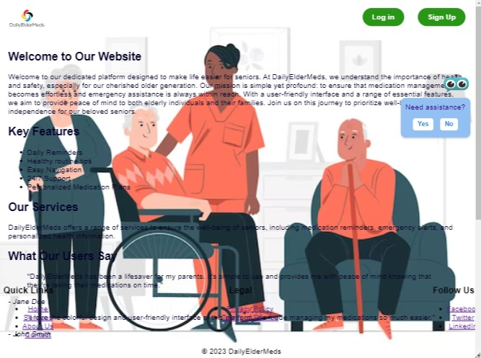
In this way our website has been created

Slide 8
Future scope
Integration with wearable devices for health monitoring.
Voice recognition and commands for hands-free interaction.
Expanding the user base to include caregivers and medical professionals.

Slide 9
Thank you

Slide 10
Team Name: Quantx
Team Member : Aarya V Ashtankar
Dhruv D Barapatre
Riya P Fulzele
Aditya Koche

